Slide 1
Digital Business and E-Commerce Management
Lesson 7
Setting a Shopify Site (B2C) Part 1

Slide 2
Setting a Shopify Site (B2C) Part 1
At the end of this lesson, you will be able to
Familiar with E-commerce Business-to-Consumer platform
Use E-commerce B2C platform to implement digital business strategies
Create an account in a B2C platform (Shopify)
Explore B2C platform account (Shopify)

Slide 3
Activity 7.1
Refer to your book for Activity 7.1

Slide 4
What is Business-to-Consumer (B2C)?
Commerce between a business and an individual
Online selling or e-tailing
Establishing online presence to stay competitive

Slide 5
What is Business-to-Consumer (B2C)? (Five business models of B2C sales)
Direct Selling
Online Retail shops which consumer buy products
Online Intermediaries
Putting buyers and sellers without owning the products or services
Advertising-based
Uses high-quality free content to attract site visitors, who then encounter online ads.
Community-based
Online communities built around shared interests to help advertisers market their product to users
Fee-based
Charge a subscription fee for access to their content.

Slide 6
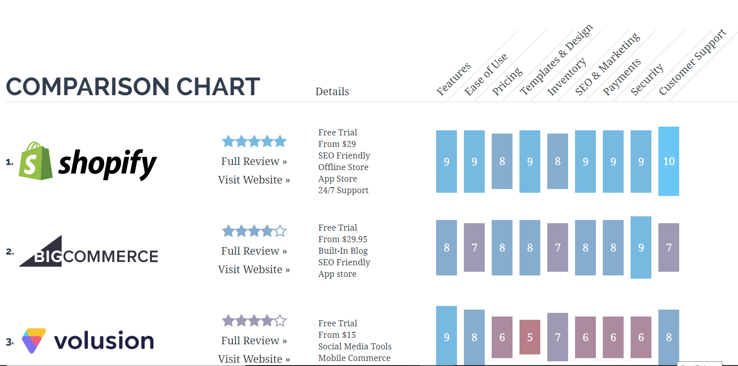
E-commerce Platforms and Shopping Cart Software

Slide 7
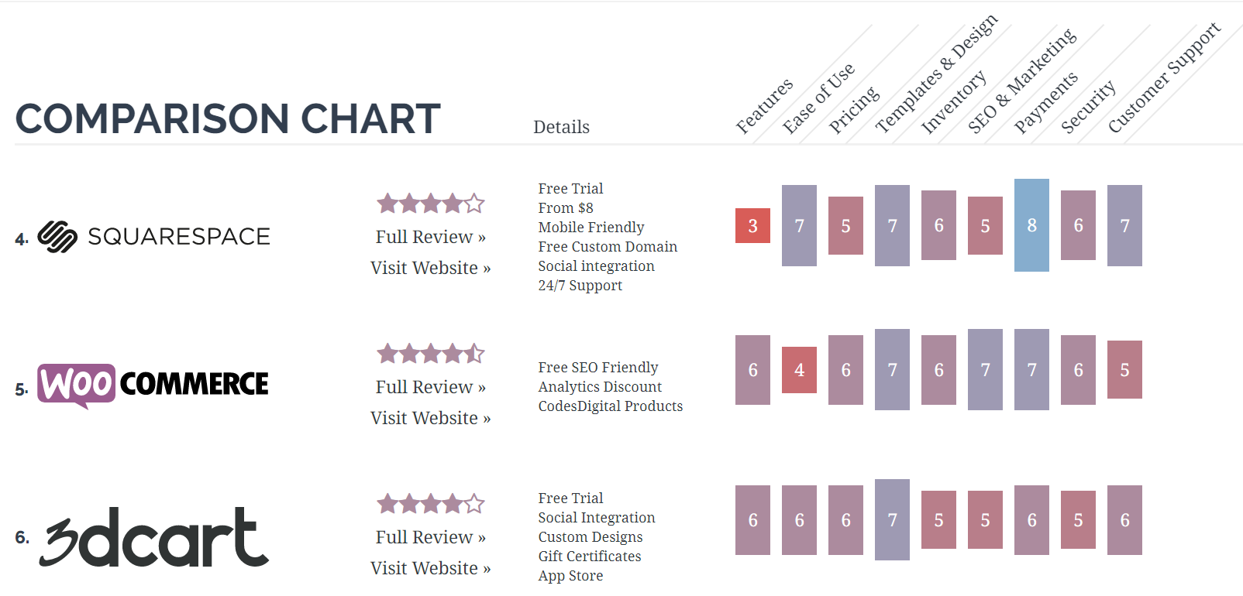
E-commerce Platforms and Shopping Cart Software

Slide 8
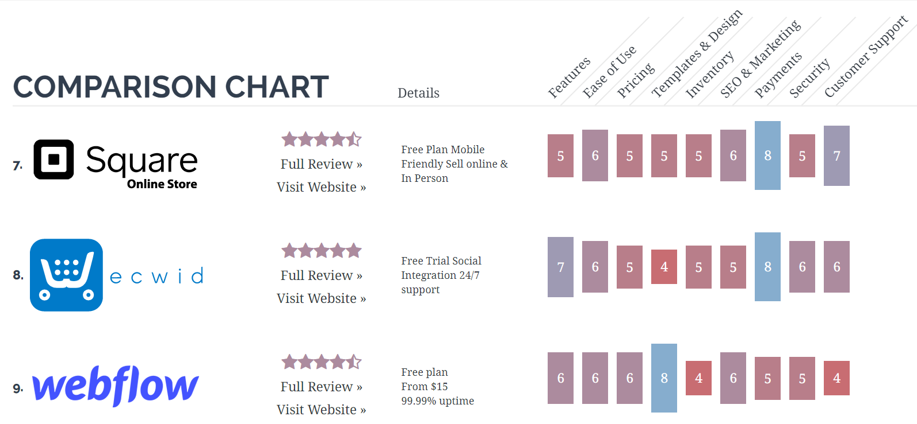
E-commerce Platforms and Shopping Cart Software

Slide 9
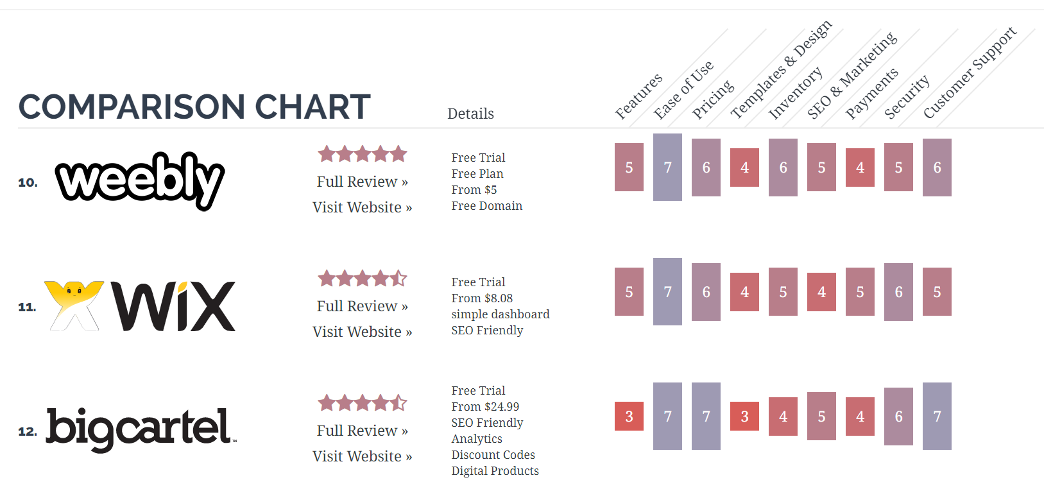
E-commerce Platforms and Shopping Cart Software

Slide 10
Activity 7.2
Refer to your book for Activity 7.2

Slide 11
What is Shopify and how does it work?
Shopify is a software that you pay for using the SaaS model – in other words, you subscribe for the service.
Owners and merchants can create a website and use an in-built shopping cart solution to sell both digital and physical products to customers around the world.
SaaS – Software as a Service

Slide 12
What is Shopify and how does it work?
Shopify is a platform that allows you to create a store without any need for major web design skills, programming or any further knowledge that the casual user of the web probably has.

Slide 13
Pre-Planning your Shopify Store
Before you sign up for your free trial or choose a Shopify plan you are going to want to do some preplanning.
As the axiom goes: if you don’t have a destination in mind you have very little chance of arriving there, which means that unless you plan out your store beforehand you are probably not going to be able to laser target it to a niche like you want.

Slide 14

Pre-Planning your Shopify Store (The way to start your Shopify store is asking by yourself some questions like these)
Do you plan on selling real-world products, digital products or services? Is your pricing based upon a purchase model or a subscription model?
Do you have enough products within that niche to fill a store? Do you have the budget to buy enough inventory to be assured of appealing to enough people?

Slide 15

Pre-Planning your Shopify Store (The way to start your Shopify store is asking by yourself some questions like these)
What basic store design are you looking for?
How are you planning on fulfilling your orders? Are you going to use Shopify’s printing labels, your own fulfillment method or are you using a dropshipper?
What forms of payment are you going to offer? Are you going to use the Shopify included payment gateways or set up something on your own?

Slide 16
Activity 7.3
Refer to your book for Activity 7.3

Slide 17
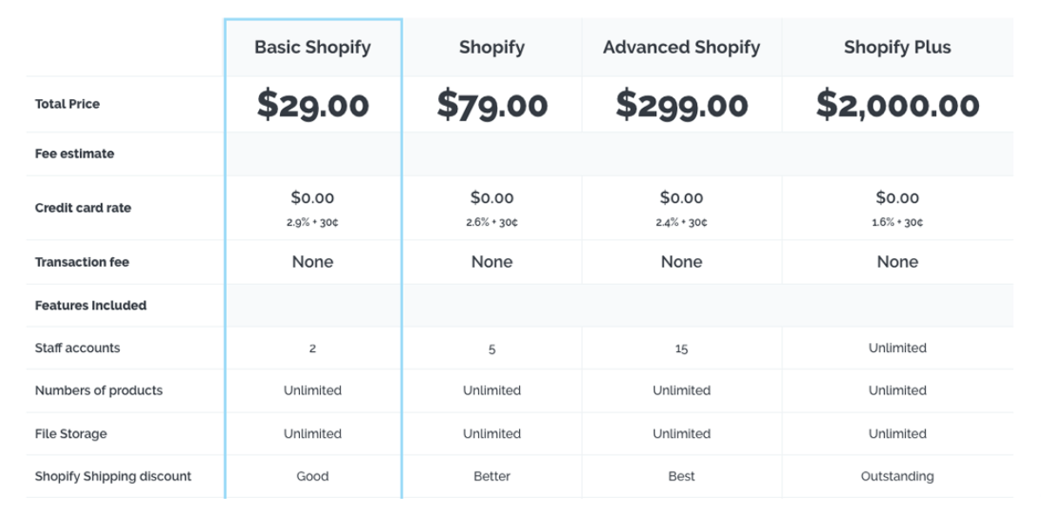
Shopify Pricing – How much does Shopify Cost?

Slide 18
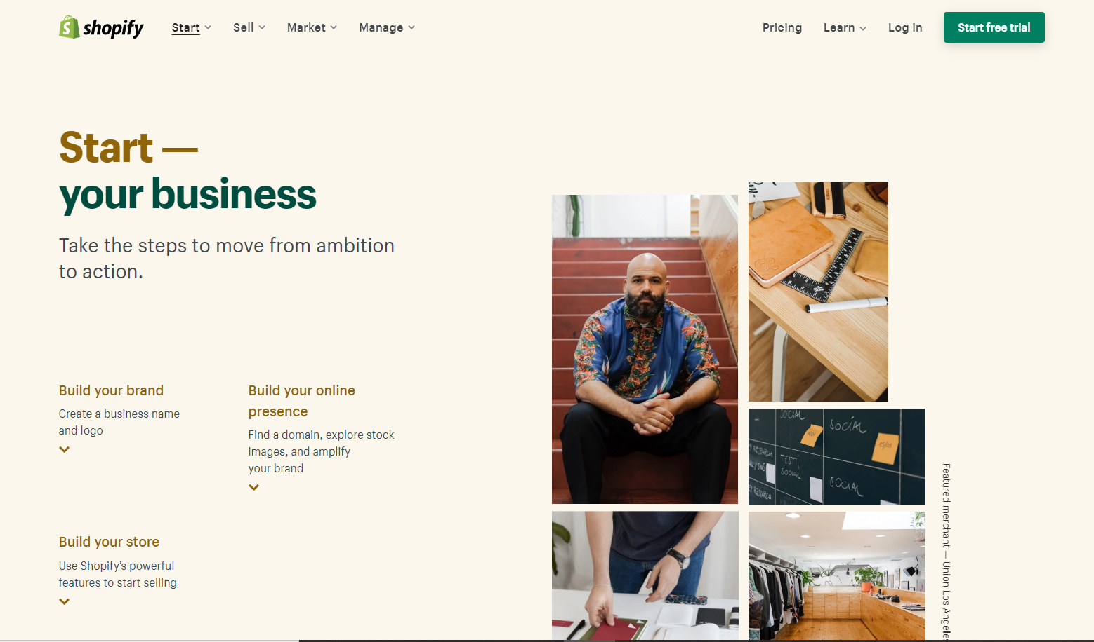
Setting a Shopify Site (B2C) 1- Sign up for Shopify
Click on the Start Free trial button to start setting up the Shopify account

Slide 19
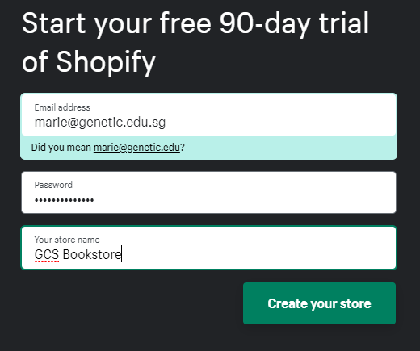
Setting a Shopify Site (B2C) 1- Sign up for Shopify
Fill up the e-mail address with your own e-mail address
Provide your own password
Name your store as per your answer in Activity 7.3
Click the “Create your store” button to sign up for Shopify account

Slide 20
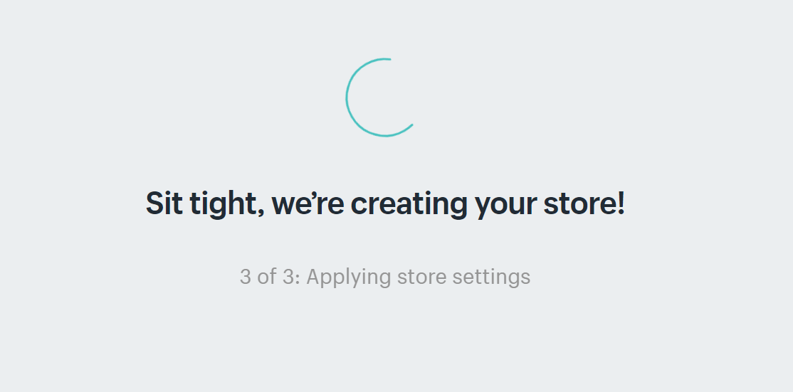
Setting a Shopify Site (B2C) 1- Sign up for Shopify
After you click the “Create you store”, the Shopify will set up necessary components of your B2C Shopify site and applies necessary store settings.

Slide 21
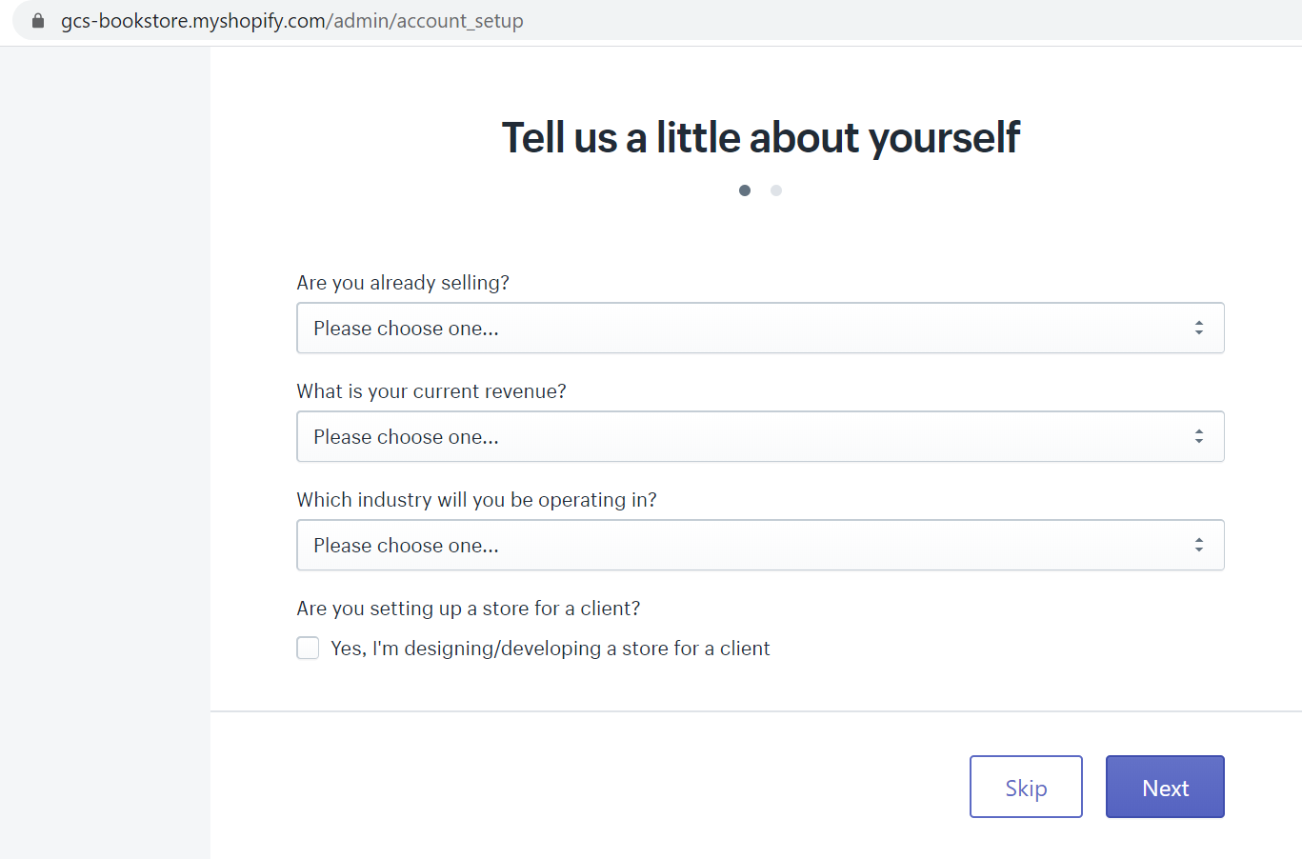
Setting a Shopify Site (B2C) 1- Sign up for Shopify
Notice that the name of your business will be part of the default domain name for your free trial Shopify site. But this can be change later once you buy your own domain name

Slide 22
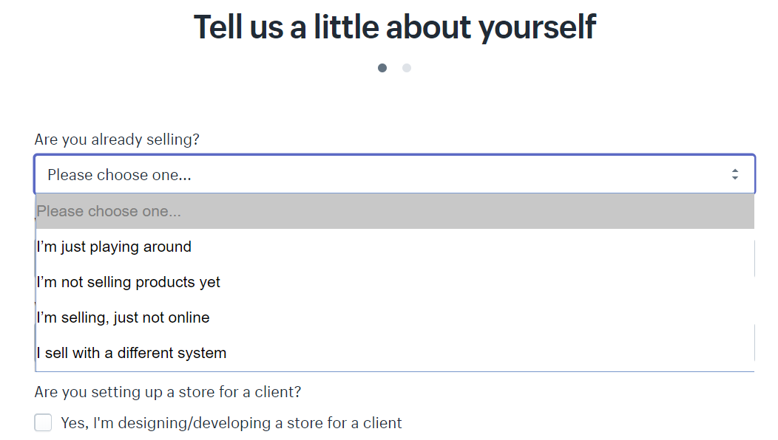
Setting a Shopify Site (B2C) 1- Sign up for Shopify
In this section you need to select the most appropriate answers according to your pre-planning.

Slide 23
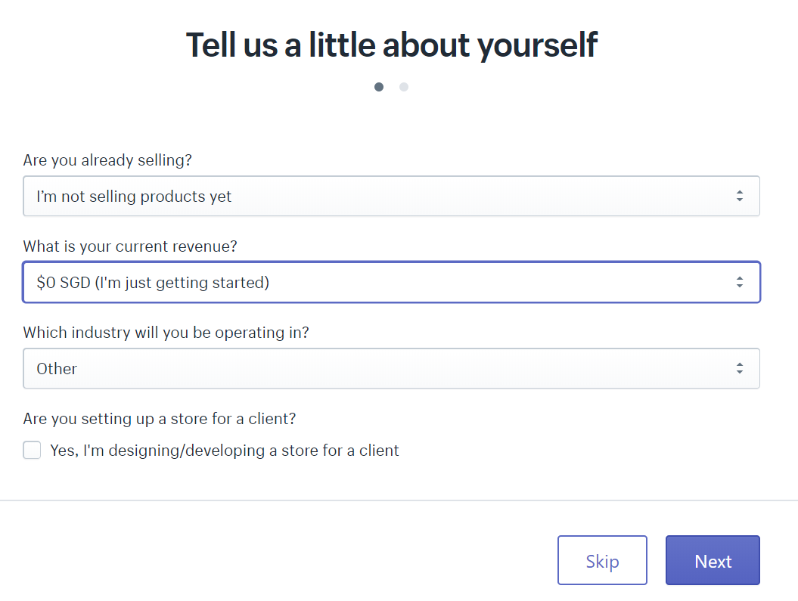
Setting a Shopify Site (B2C) 1- Sign up for Shopify
The answers will differ depending on the strategies of your digital business and that of your pre-planning.

Slide 24
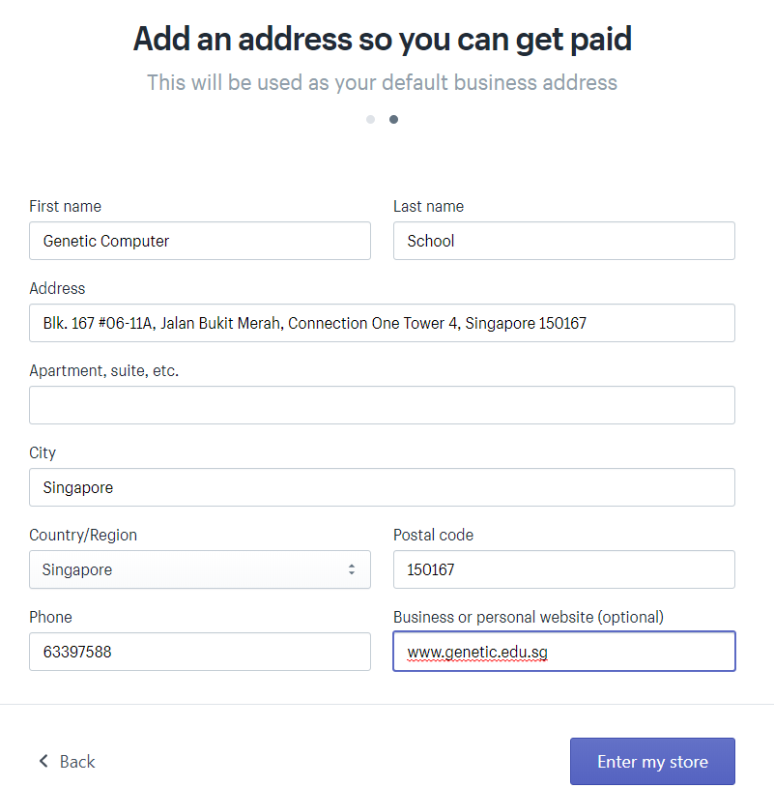
Setting a Shopify Site (B2C) 1- Sign up for Shopify
Fill up based on your pre-planning information.
Please do take note that this may change if the real business Shopify site is set-up.

Slide 25
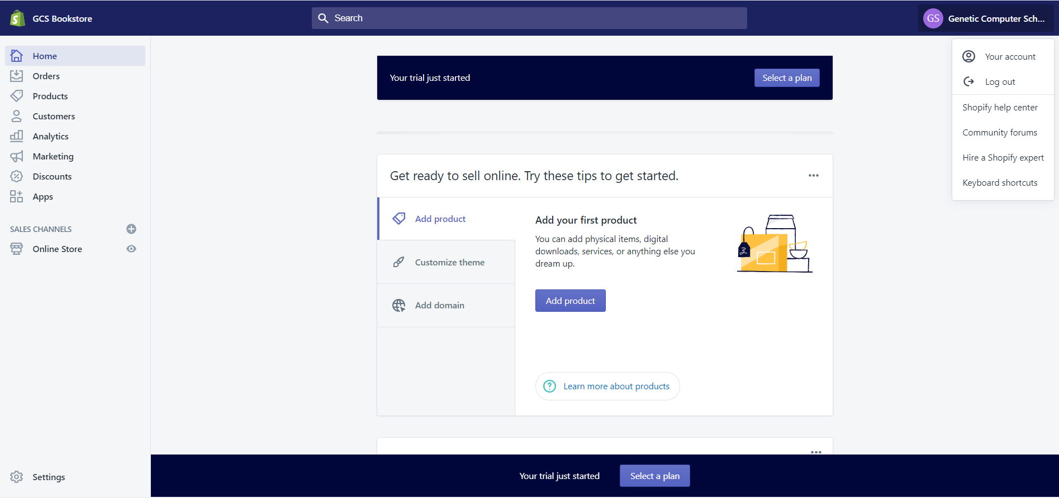
Setting a Shopify Site (B2C)
Once you successfully sign-up for a Shopify account, the software will take you to the admin screen for your new site. This is where you can start customizing your store.

Slide 26
Activity 7.4
Refer to your book for Activity 7.4

Slide 27

Setting a Shopify Site (B2C) 2- Adding Product to the Shopify site
The Add product page is like something you would see on WordPress.
You can fill in details like a title, description, price, and vendor. Feel free to complete however much of the product page you'd like. Just make sure you save the product at the end.
Remember, the images connected to your product can make or break your chances of a sale, so it makes sense to choose images that will appeal to your target audience.

Slide 28
Setting a Shopify Site (B2C) 2- Adding Product to the Shopify site
Another thing to keep in mind is that you can set up collections or groups of products according to your individual needs too. For instance, if you were a clothing website, you would be able to set up a page that was specifically for men’s clothing, or specifically for shoes and accessories.

Slide 29
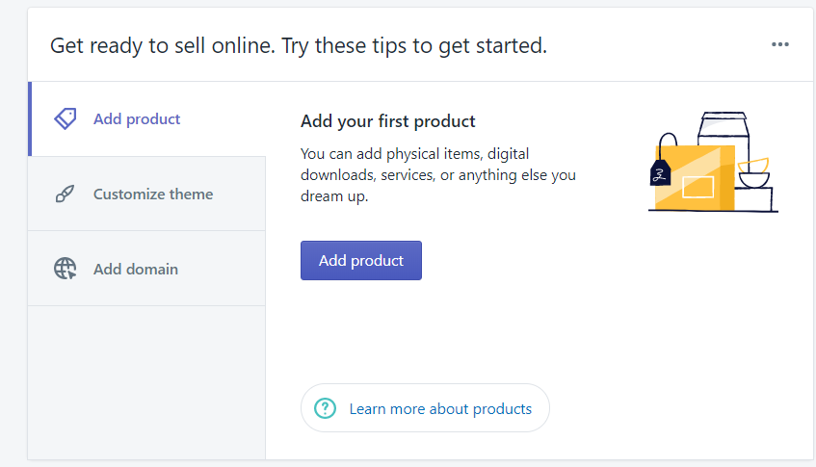
Setting a Shopify Site (B2C) 2- Adding Product to the Shopify site
Click on the “Add Product” button to start adding products to the Shopify site.

Slide 30
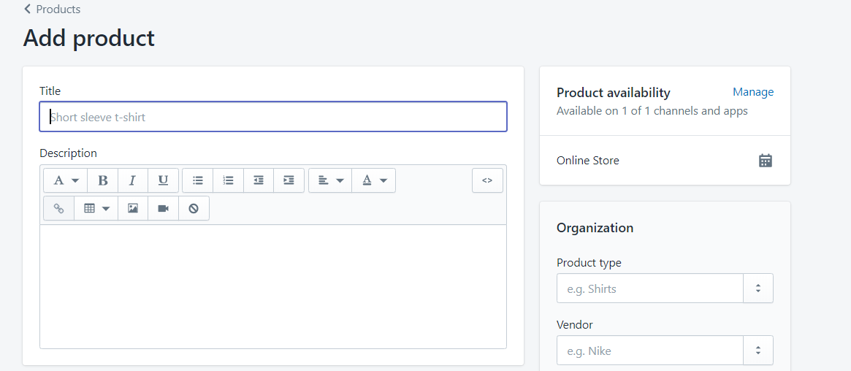
Setting a Shopify Site (B2C) 2- Adding Product to the Shopify site
Fill the details of the product from title, description, product type and etc.

Slide 31
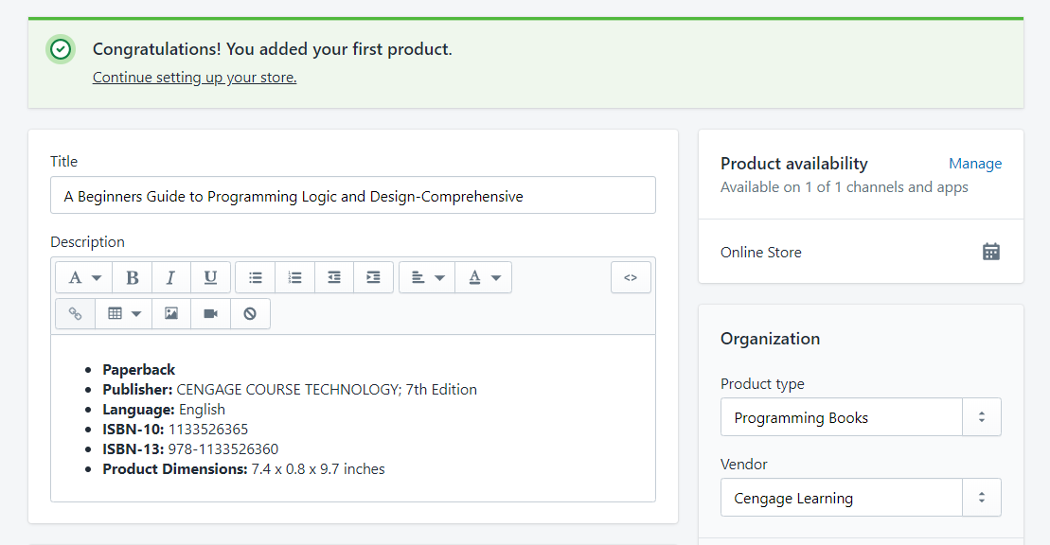
Setting a Shopify Site (B2C) 2- Adding Product to the Shopify site
Fill the details of the product from title, description, product type and etc.

Slide 32
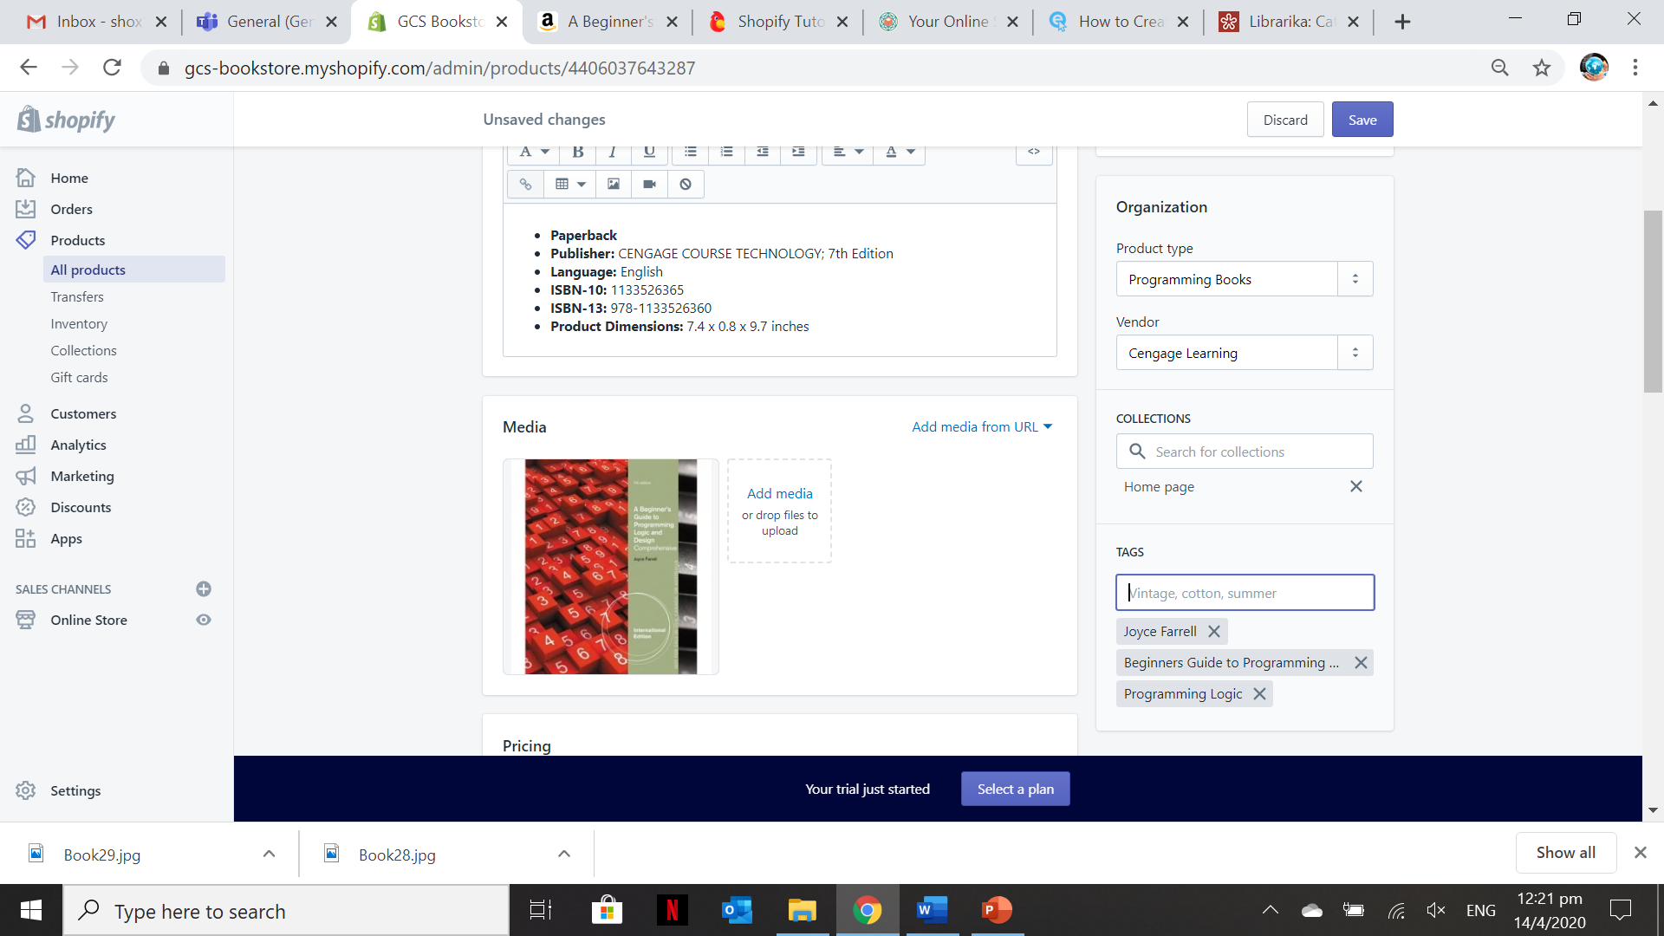
Setting a Shopify Site (B2C) 2- Adding Product to the Shopify site
Use the images you downloaded from the Internet in Activity 7.4. You can also add Tags and make it as part of the Collection in the Home Page

Slide 33
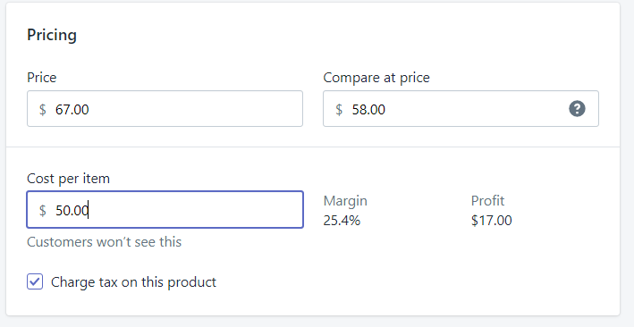
Setting a Shopify Site (B2C) 2- Adding Product to the Shopify site
This section in the “Add Product” allows you to specify the price you want to sell the product, the compared price and original cost of the product. If you want to chart tax on the product tick on the “Charge tax on this product”

Slide 34
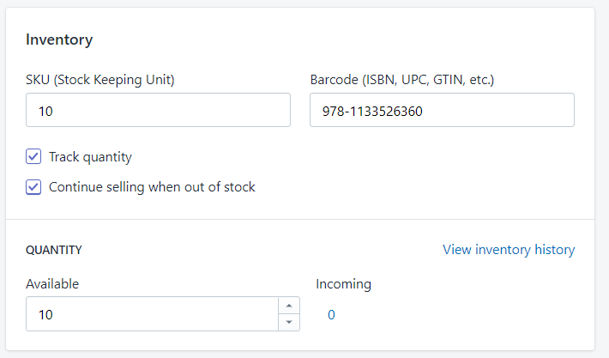
Setting a Shopify Site (B2C) 2- Adding Product to the Shopify site
This will allow you to provide the inventory information of the products you are selling. This is mostly applicable to physical products and not services.

Slide 35
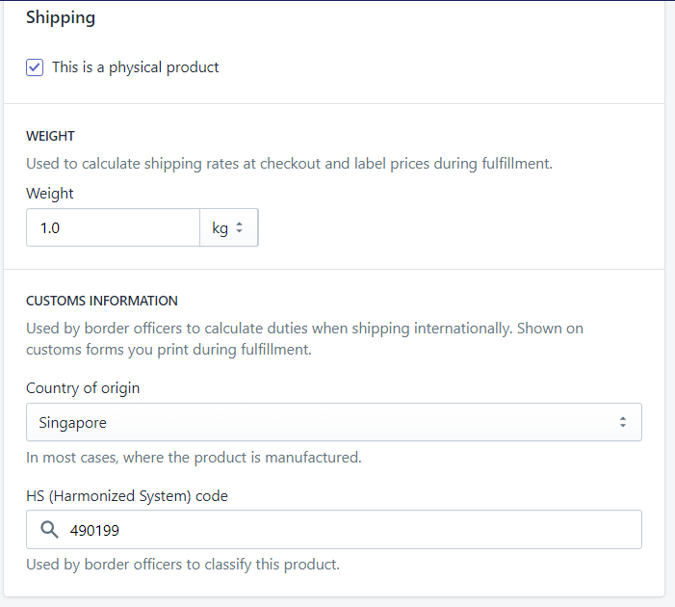
Setting a Shopify Site (B2C) 2- Adding Product to the Shopify site
If you want to ship the product internationally, then enter the harmonized system (HS) tariff code. These codes provide customs with information so that correct tariffs can be applied to the order.

Slide 36
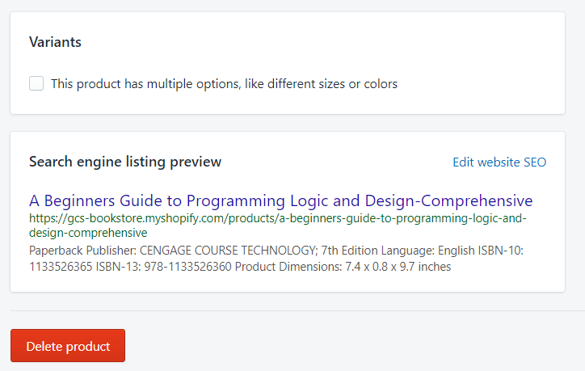
Setting a Shopify Site (B2C) 2- Adding Product to the Shopify site
For a product that has variants, this section shows the options for the product, such as color and size.
A preview of how your product will appear in search engine results. Click Edit website SEO to make changes to the preview.

Slide 37
Setting a Shopify Site (B2C) 2- Adding Product to the Shopify site
For more information on each product details you can visit the link below:
https://help.shopify.com/en/manual/products/details

Slide 38
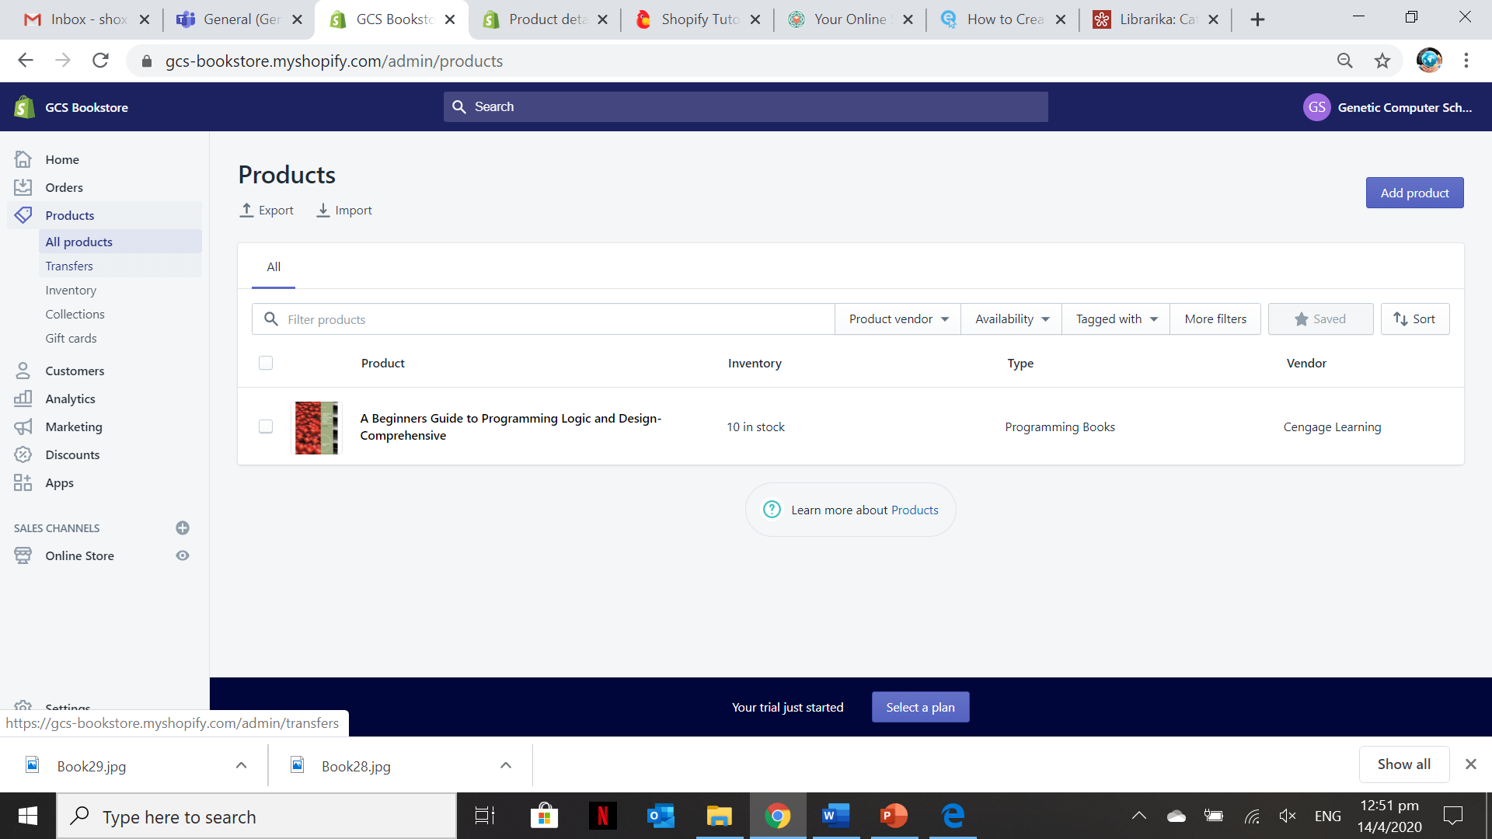
Setting a Shopify Site (B2C) 2- Adding Product to the Shopify site
Click on “Products” and
“All Products” to edit the
Information of the Products added
Click the Product Title to go to the Product Details Page and edit any information on each section
Click the “Add Product” to add more product records

Slide 39
Activity 7.5
Refer to your book for Activity 7.5

Slide 40
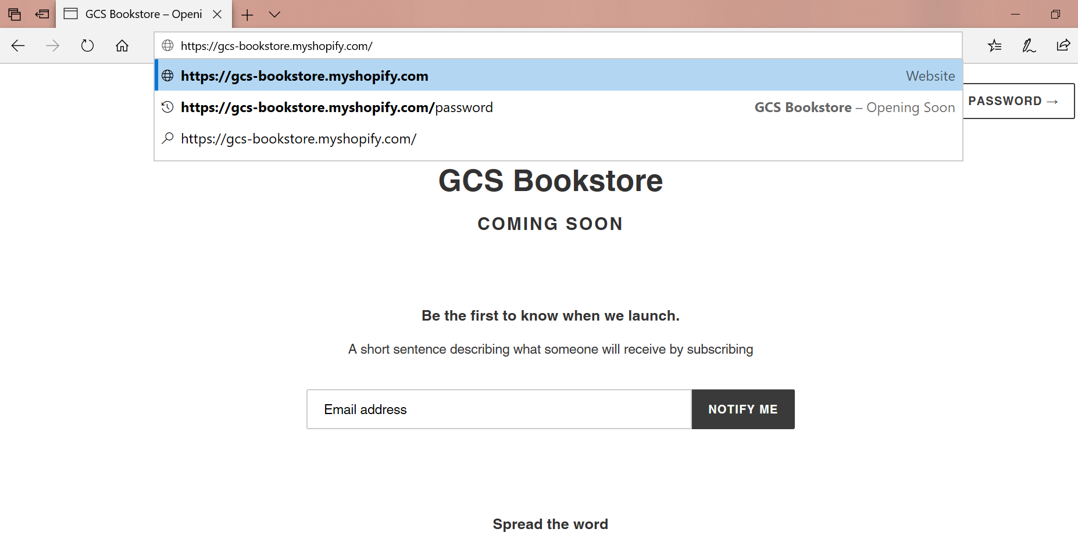
Setting a Shopify Site (B2C) 3 – To view your Shopify Site using the default site address
In the URL type the name of your company as pre-filled during Account set-up plus the .myshopify.com
It is the default domain provided by Shopify unless you use your own purchased domain name

Slide 41
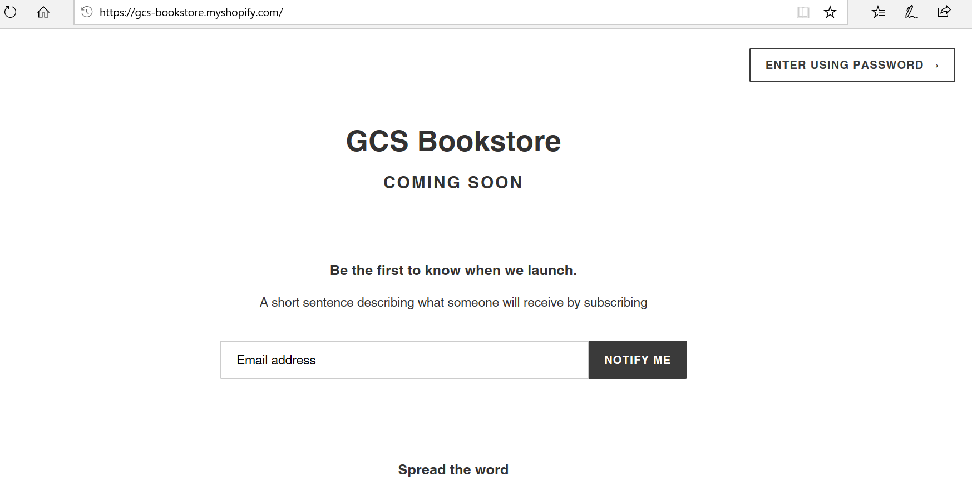
Setting a Shopify Site (B2C) 3 – To view your Shopify Site using the default site address
This is what you will see on the Shopify site page after you enter your default Shopify site URL.
You are required to enter using the password only when the “Online Store” setting is not disabled.

Slide 42
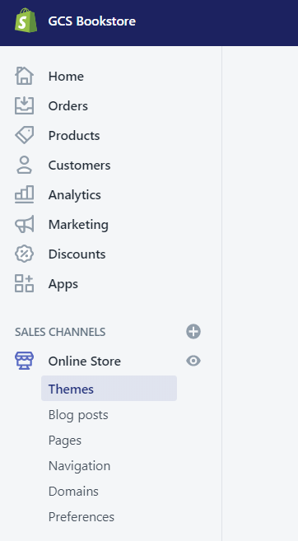
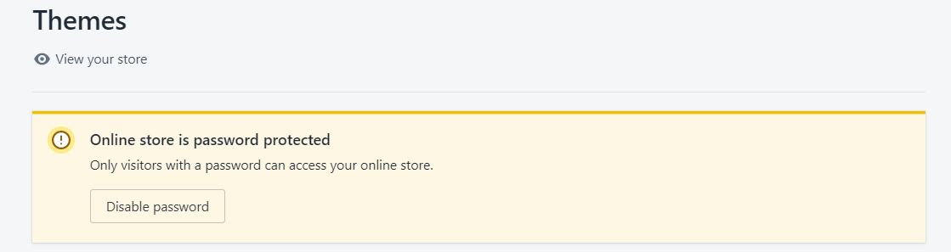
Setting a Shopify Site (B2C) 3 – To view your Shopify Site using the default site address
Click the “Online Store” in the dashboard to disable the Password when visiting your Shopify site.
Note: you can only disable if you pick a Shopify Plan and not using the free trial plan

Slide 43
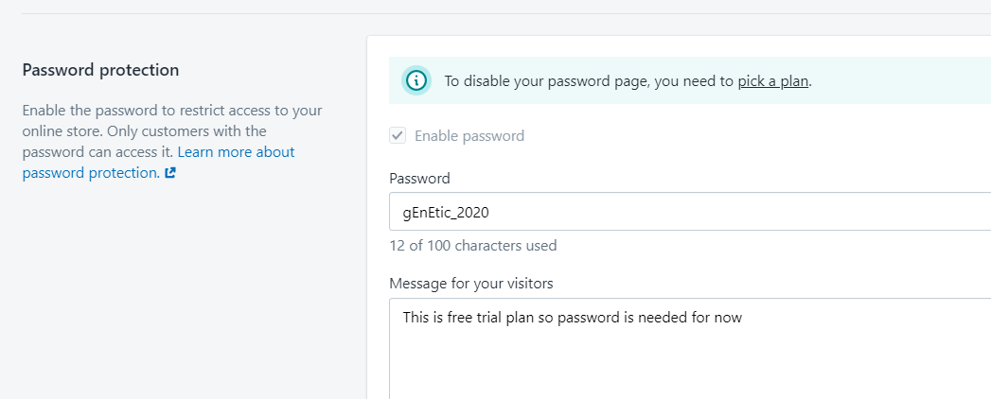
Setting a Shopify Site (B2C) 3 – To visit your Shopify Site using the default site address
Since this is still using the free trial plan. The user of the site need to input the password to completely view the site and its pages.

Slide 44
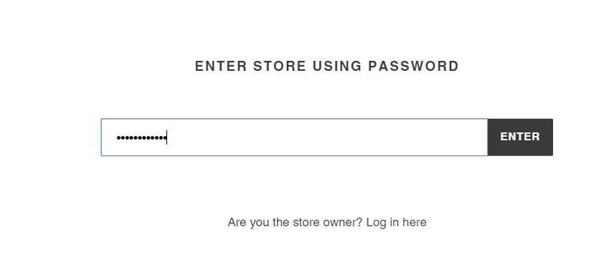
Setting a Shopify Site (B2C) 3 – To visit your Shopify Site using the default site address
Input the password as per set in the “Online Store”→ Theme section settings.

Slide 45
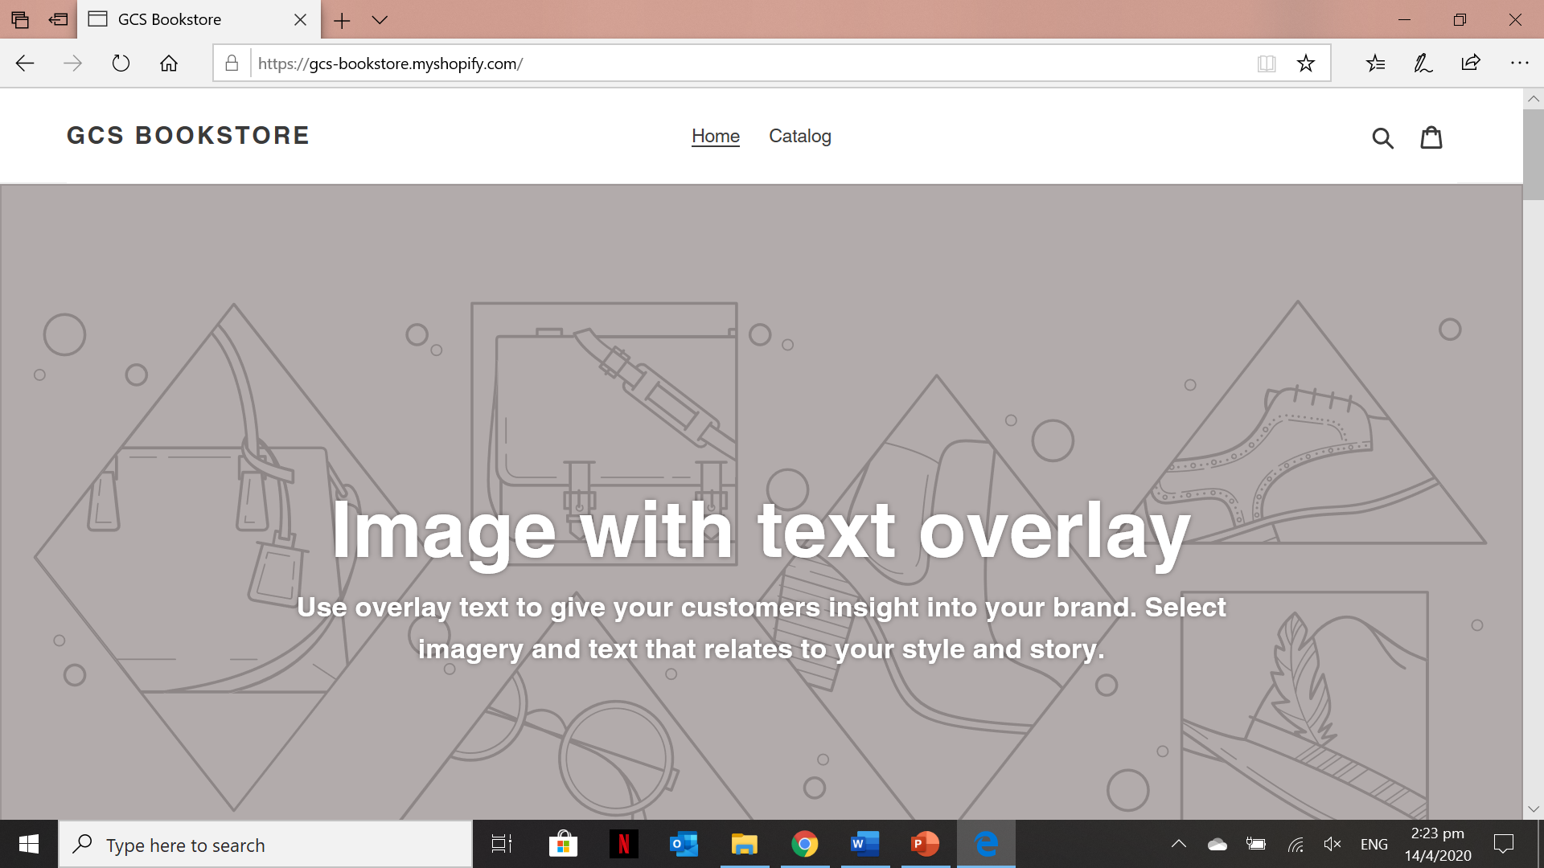
Contents of the HOME Page of the newly created Shopify site

Slide 46
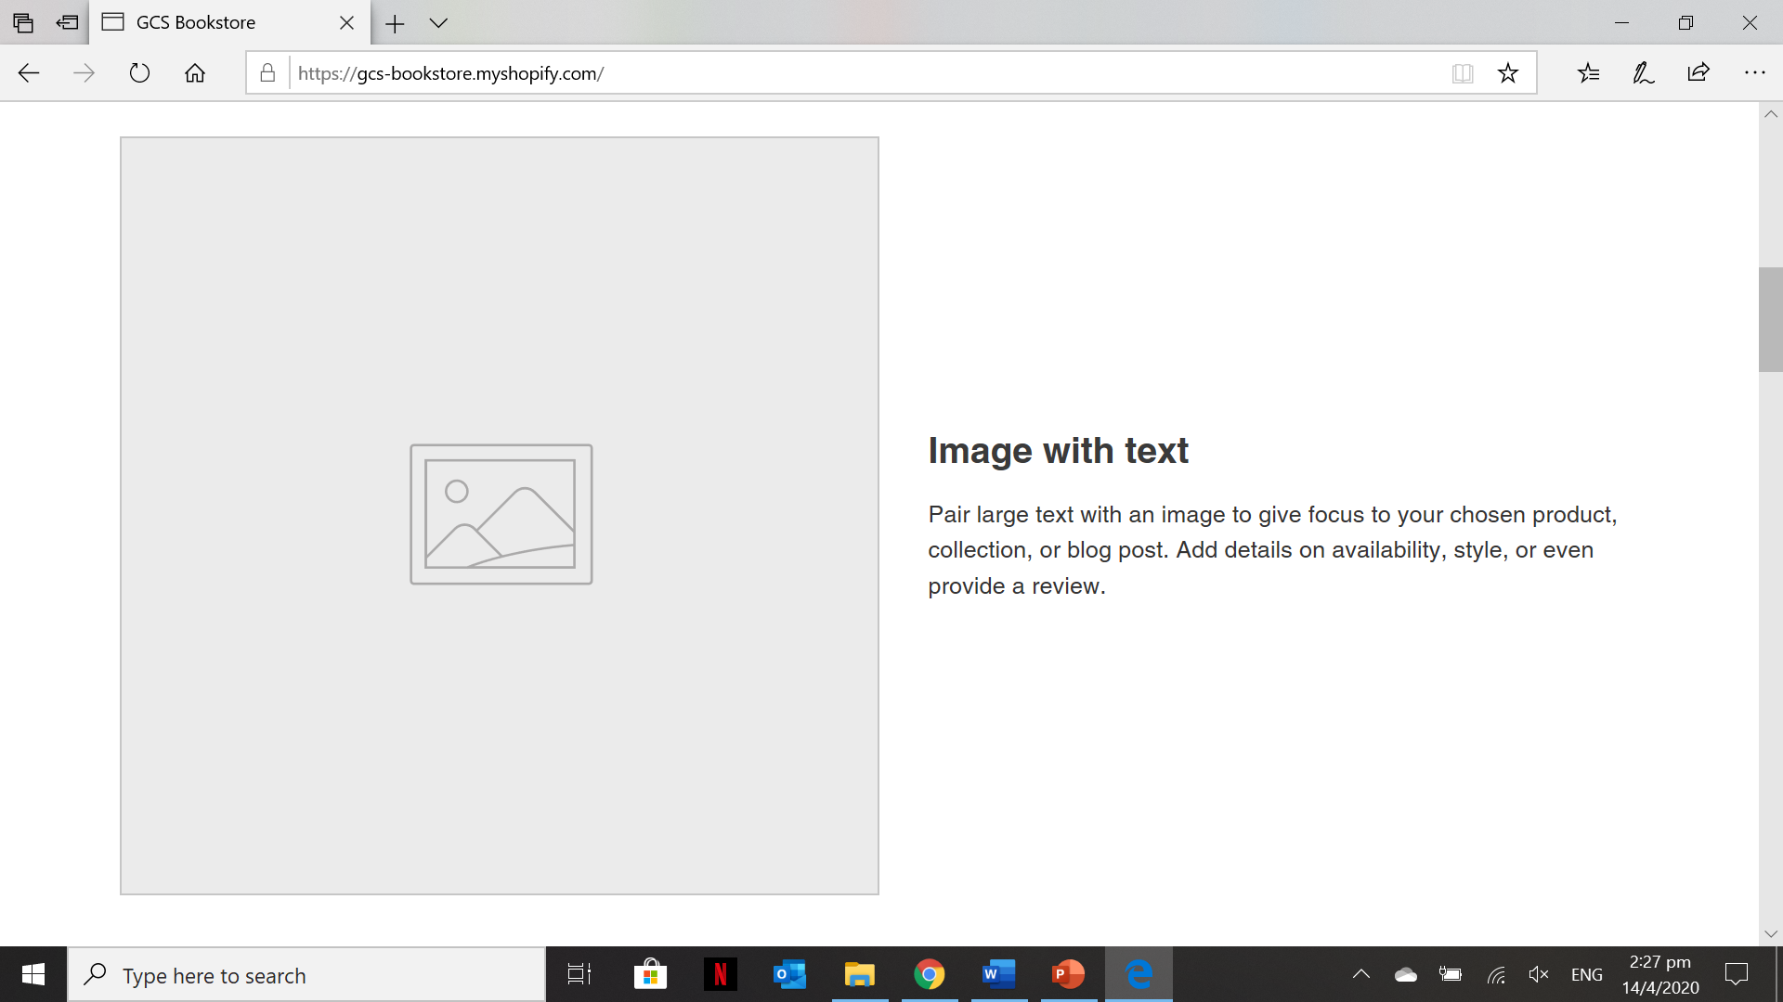
Contents of the HOME Page of the newly created Shopify site

Slide 47
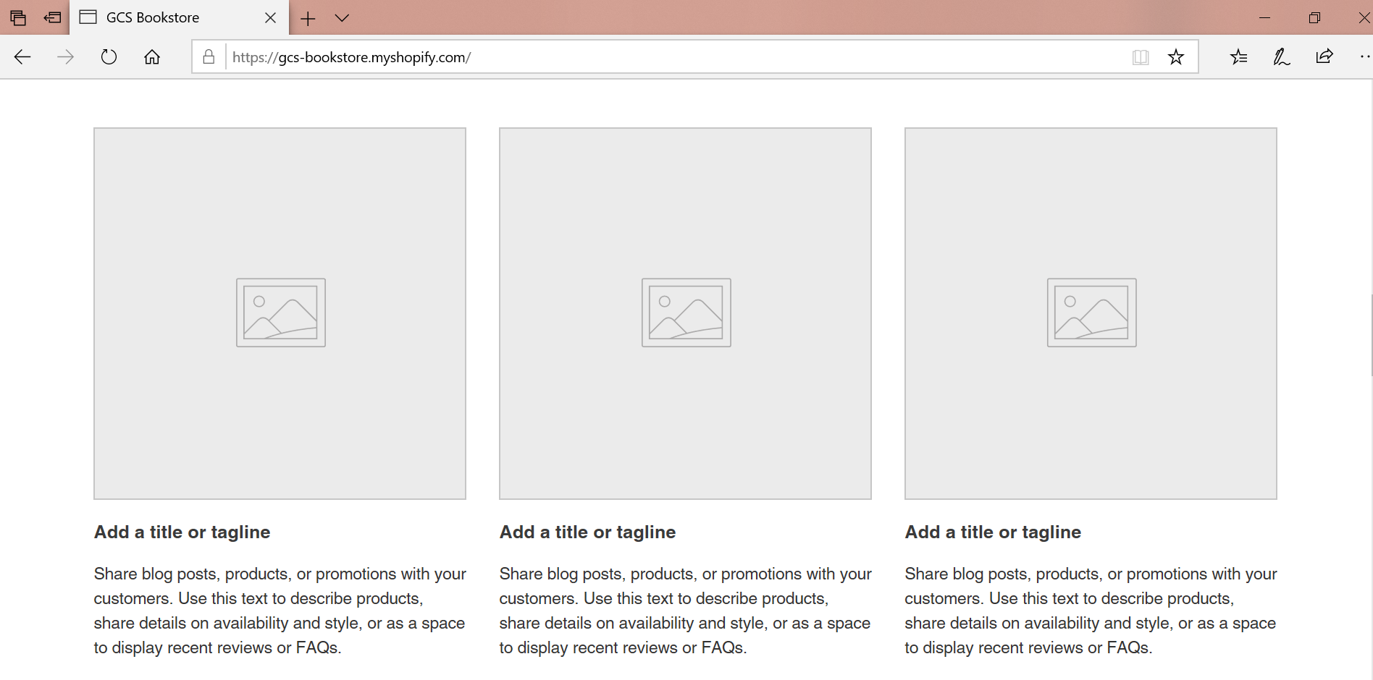
Contents of the HOME Page of the newly created Shopify site

Slide 48
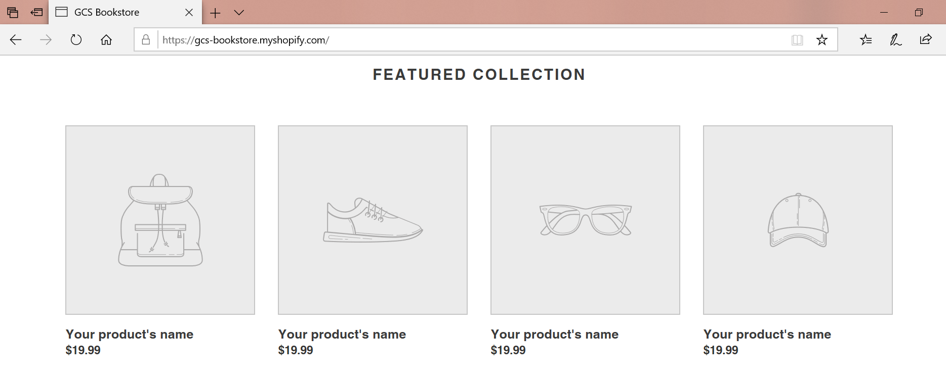
Contents of the HOME Page of the newly created Shopify site

Slide 49
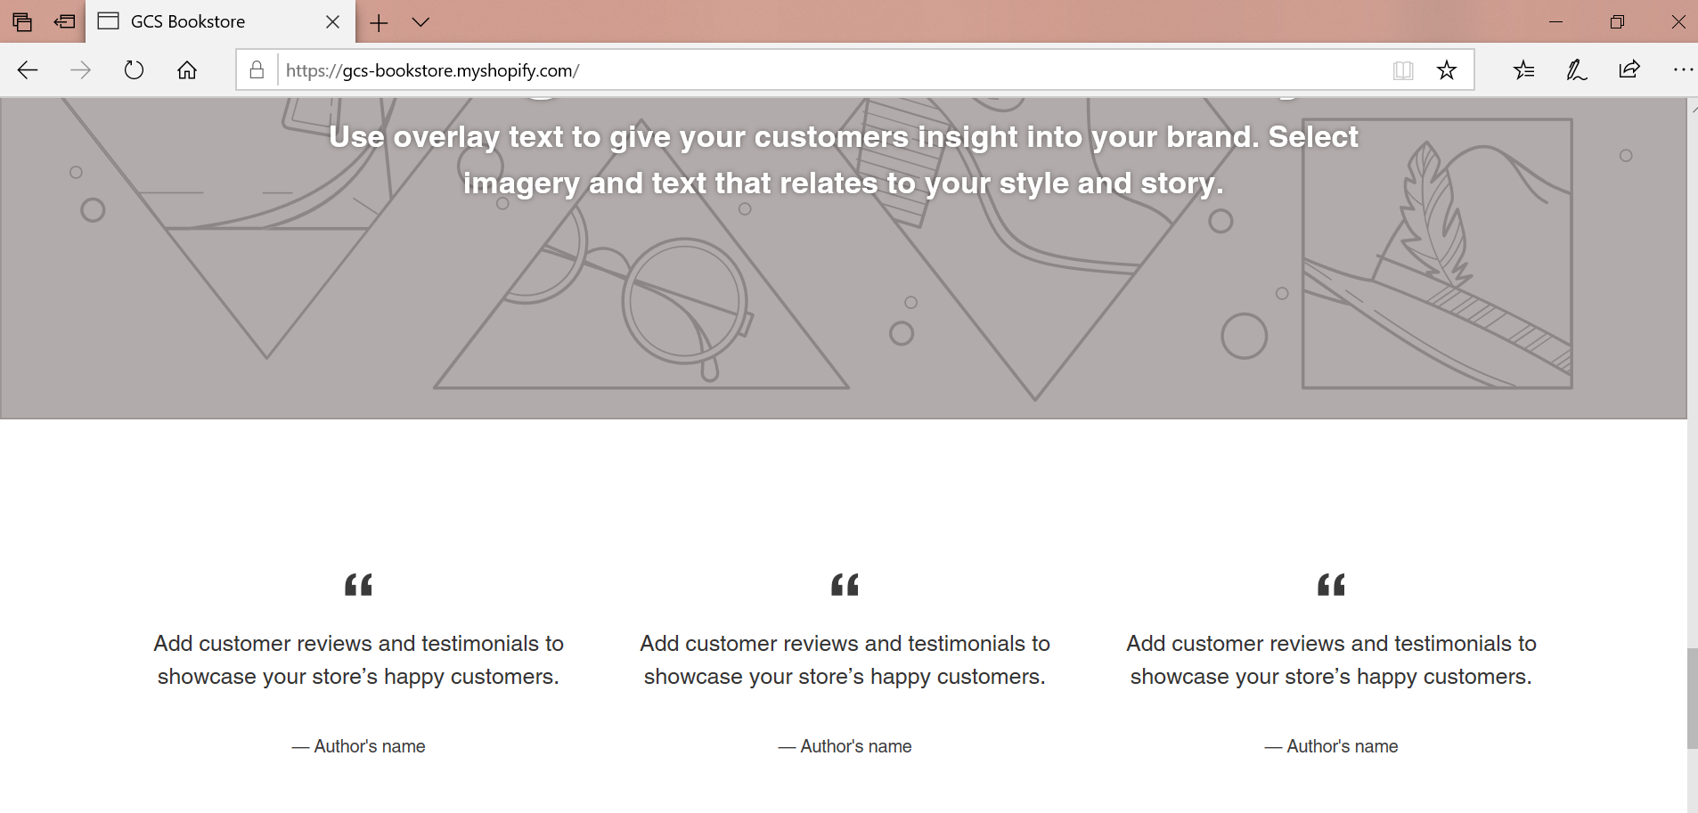
Contents of the HOME Page of the newly created Shopify site

Slide 50
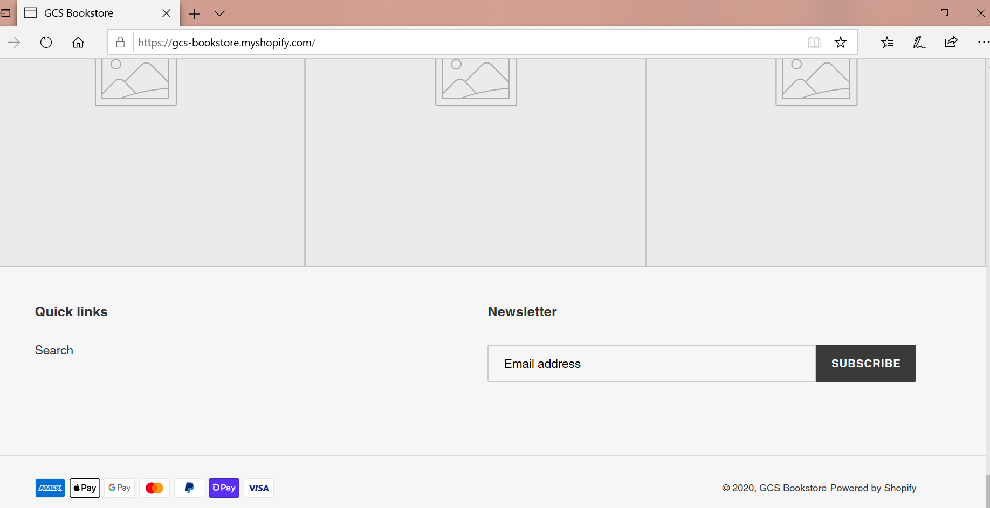
Contents of the HOME Page of the newly created Shopify site

Slide 51
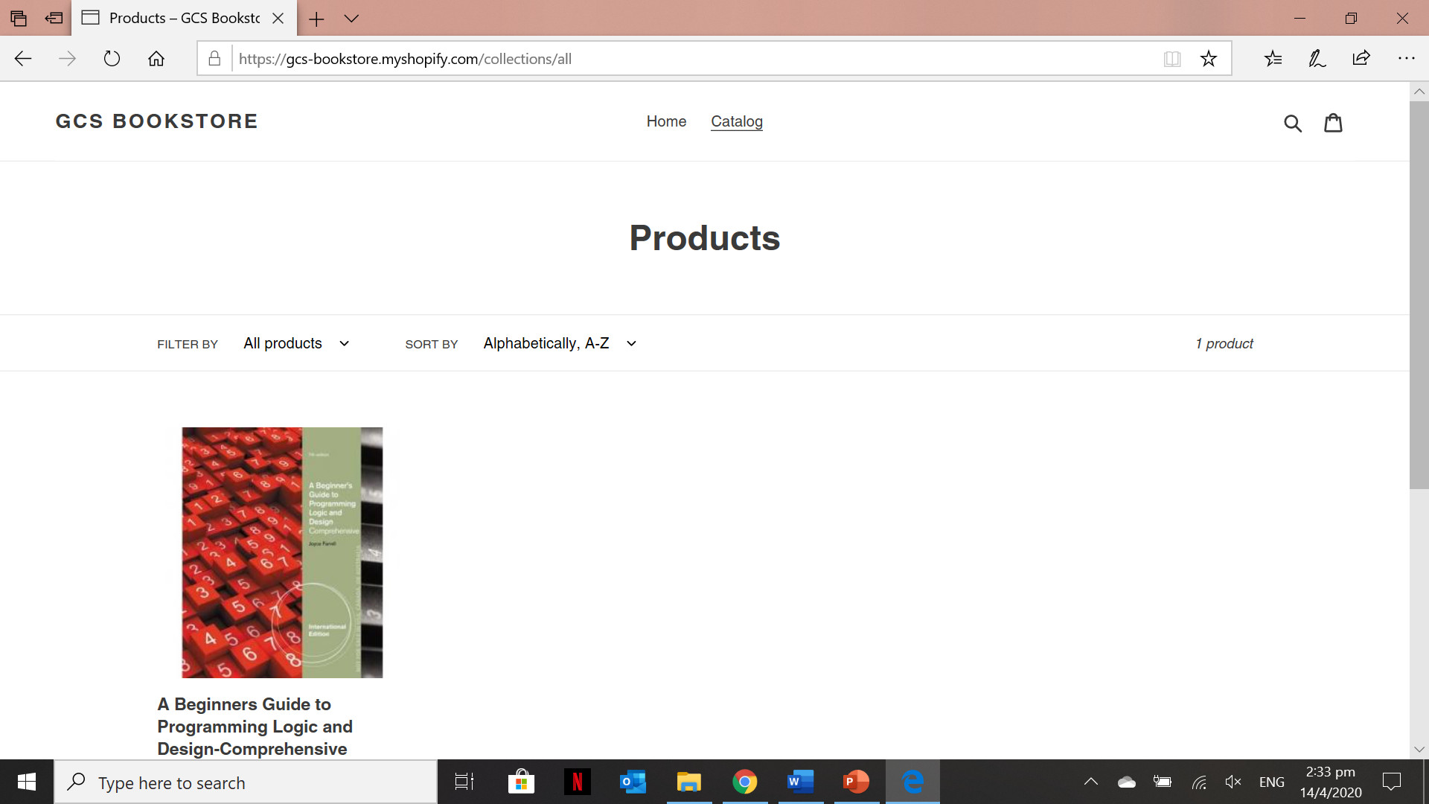
Contents of the Product Catalog Page of the newly created site
Take note if you had added the 10 products as per suggested in Activity 7.5 then you will see a list of products on this page.

Slide 52
Portfolio – Setting a Shopify Site and Add Products
The contents of your portfolio for this lesson are the following:
Account set-up and account information in Shopify
The Catalog page of your Shopify site will have ten (10) product information and details.

